Slide 1
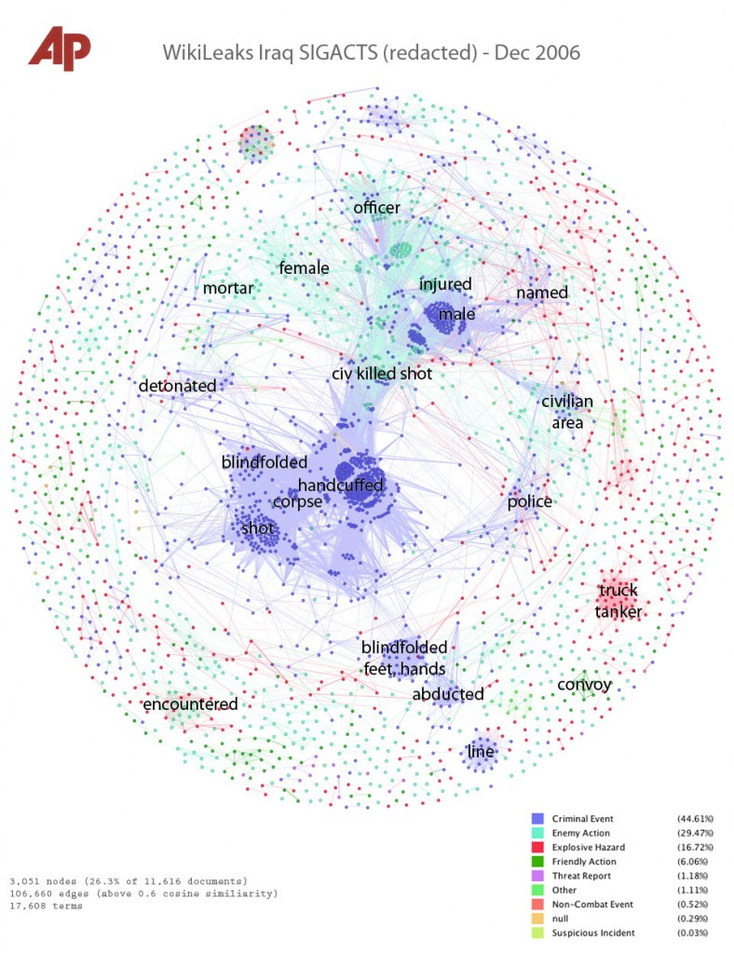
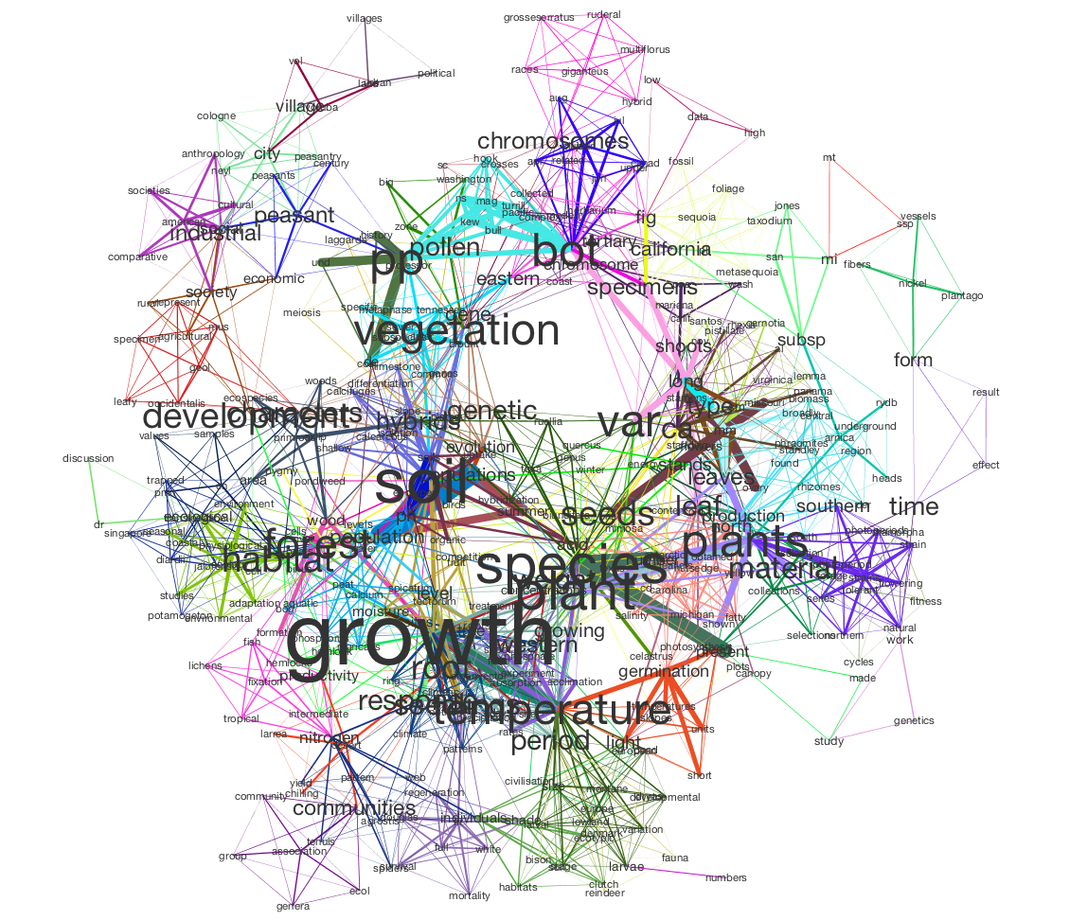
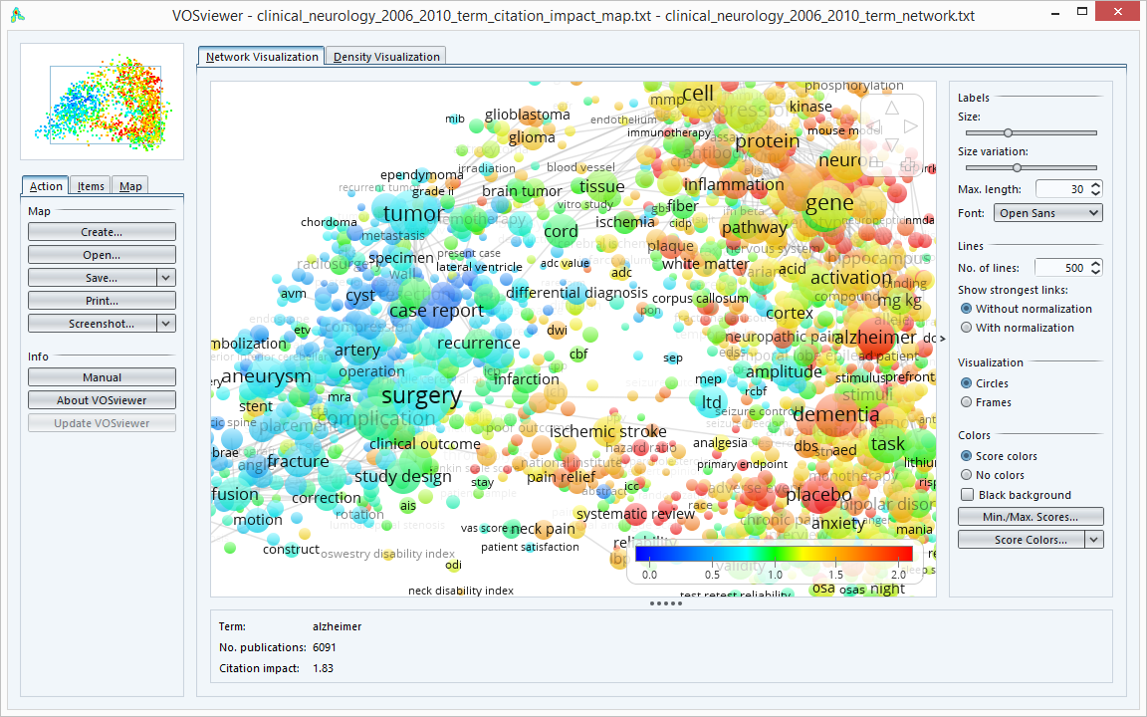
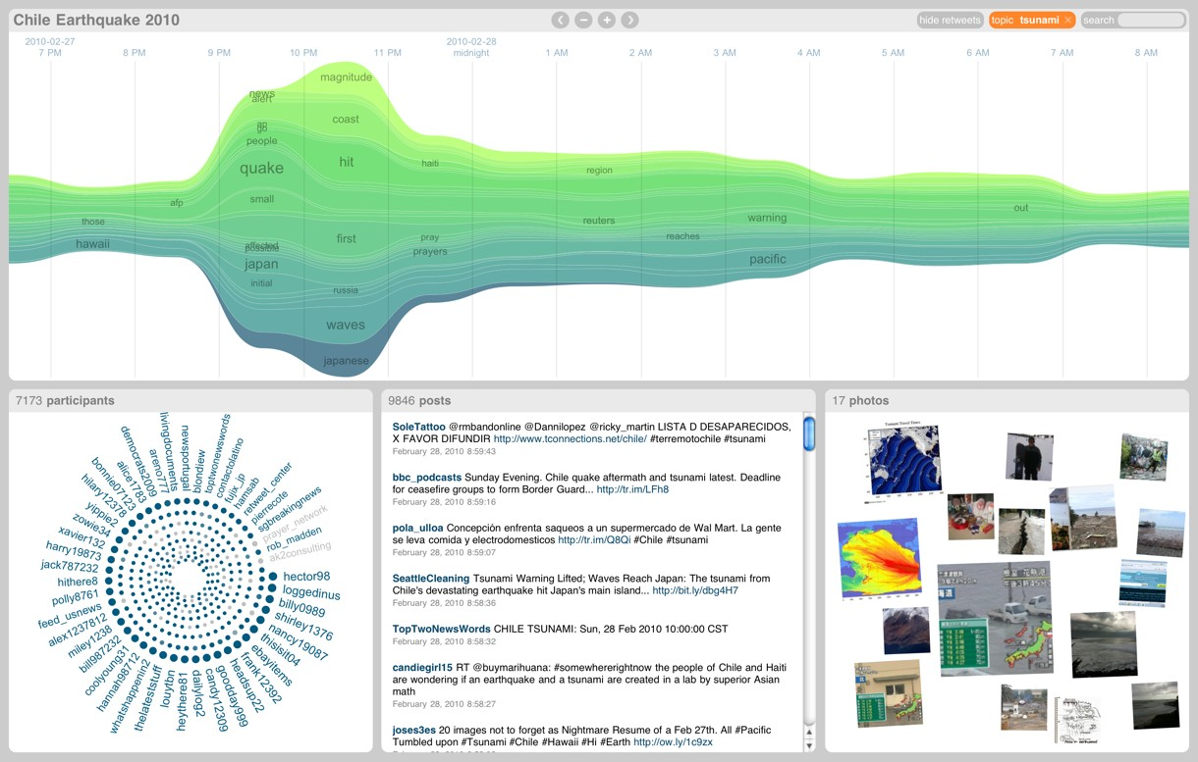
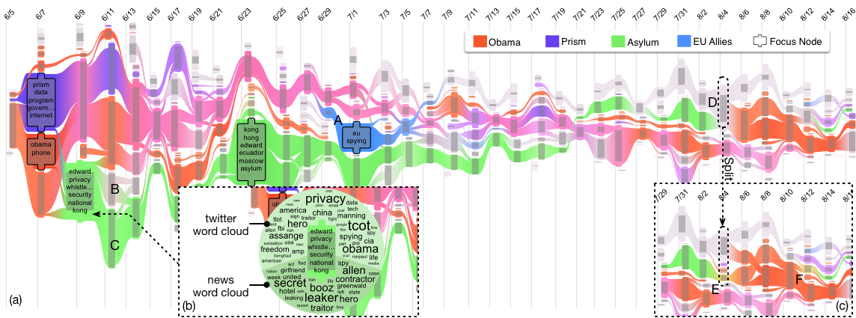
http://pythonhosted.org/tethne/tutorial.mallet.htmlx
Dork M., Gruen D., Williamson C, Carpendal S. : A visual backchannel for large-scale events. IEEE TVCG
How Hierarchical Topics Evolve in Large Text Corpora. Weiwei Cui, Shixia Liu, Zhuofeng Wu, Hao Wei. (IEEE InfoVis'14)

Slide 2
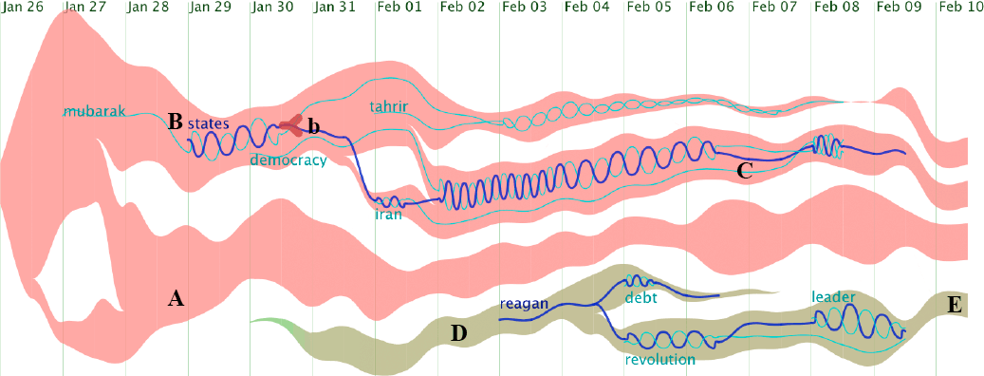
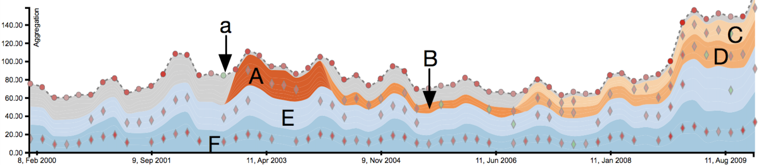
TextFlow: Towards Better Understanding of Evolving Topics in Text. Weiwei Cui, Shixia Liu, Li Tan, Conglei Shi, Yangqiu Song, Zekai Gao, Xin Tong, and Huamin Qu. IEEE Transactions on Visualization and Computer Graphics (InfoVis'11)
PieceStack: Toward Better Understanding of Stacked Graphs. Tongshuang Wu, Yingcai Wu, Conglei Shi, Huamin Qu, Weiwei Cui: IEEE Trans. Vis. Comput. Graph. 22(6): 1640-1651 (2016)

Slide 3
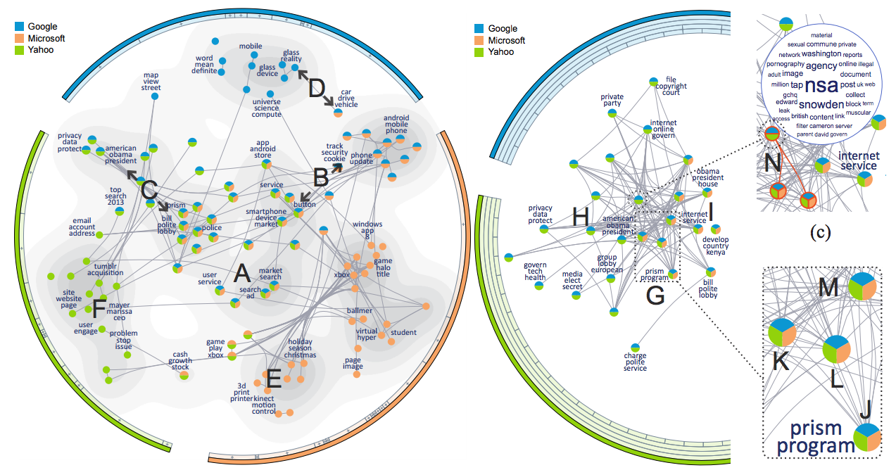
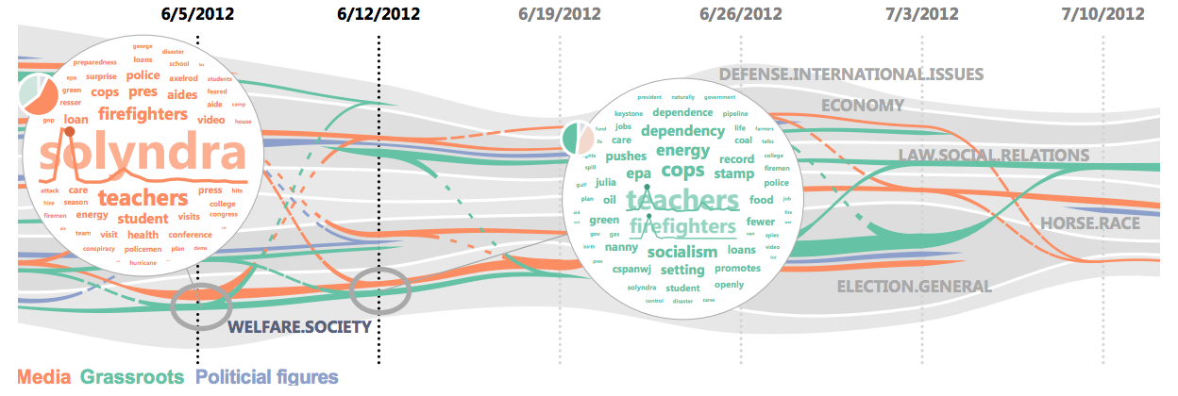
TopicPanorama: A Full Picture of Relevant Topics Xiting Wang, Shixia Liu, Junlin Liu, Jianfei Chen,
Jun Zhu, and Baining Guo
IEEE Transactions on Visualization and Computer Graphics
(2016)
Visual Analysis of Topic Competition on Social Media Panpan Xu, Yingcai Wu, Enxun Wei, Tai-Quan Peng,
Shixia Liu, Jonathan J.H. Zhu, Huamin Qu, IEEE Transactions on Visualization and Computer Graphics (VAST'13)

Slide 4
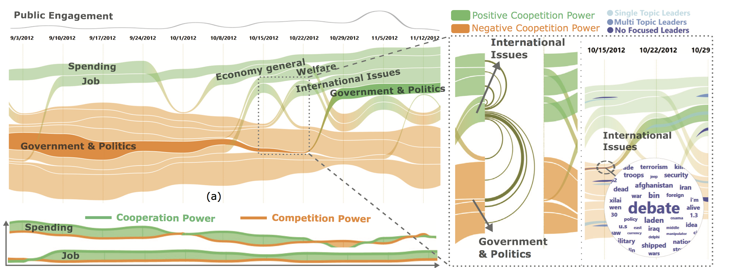
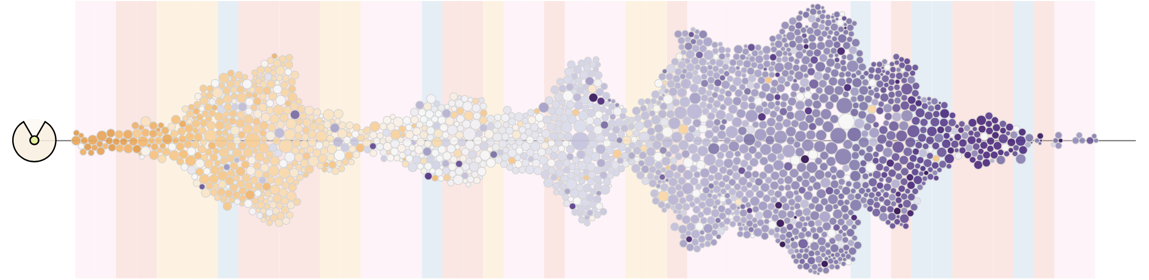
EvoRiver: Visual analysis of topic competition on social media.
G. Sun, Y. Wu, S. Liu, T. Peng, J. J. H. Zhu, and R. Liang.
IEEE TVCG 2014
FluxFlow: Visual Analysis of Anomalous Information Spreading on Social Media.
Jian Zhao, Nan Cao, Zhen Wen, Yale Song, Yu-Ru Lin, Christopher Collins.
VAST 2014

